Slide 1
Enhancing Atmospheric Gravity Wave Studies through Advanced Cloud Classification and Segmentation in Satellite Infrared Imagery: A Contribution to the AWE Mission
Anh Phan, Dallin Tucker, P.-Dominique Pautet, Yucheng Zhao, Ludger Scherliess, and Mike J. Taylor
Utah State University, Logan, Utah
The material is based upon work supported by the National Aeronautics and Space Administration under Contract Number 80GSFC18C0007. Any opinions, findings, and conclusions or recommendations expressed in this material are those of the author(s) and do not necessarily reflect the views of NASA.

Slide 2
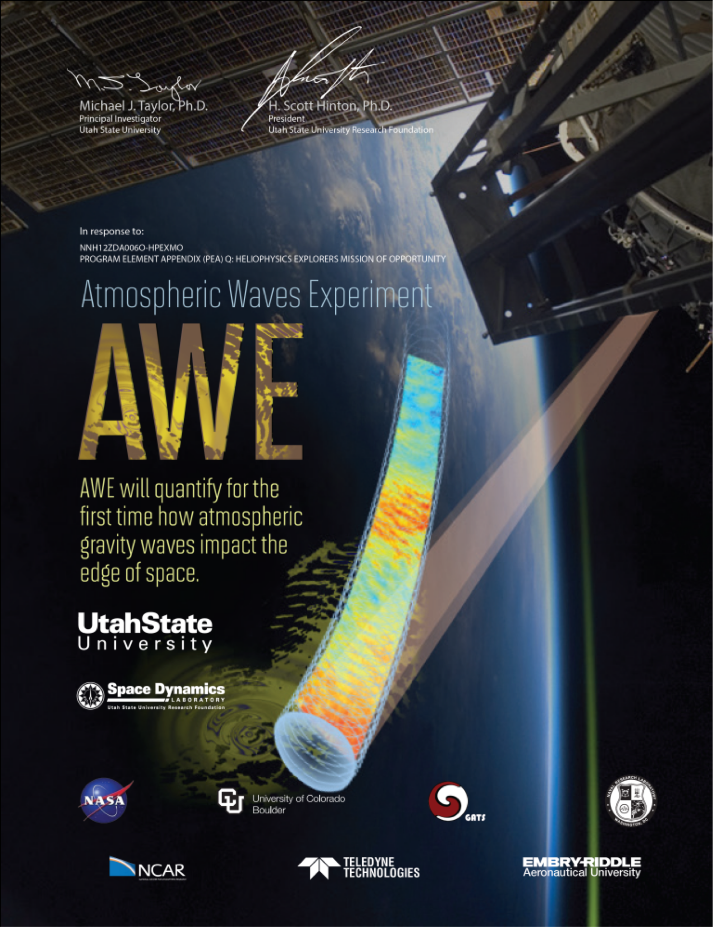
Introduction
Objectives:
Understanding how Earth's weather influences space weather by studying atmospheric gravity waves (AGWs).
AGWs are a key feature of the atmosphere as they transport energy and momentum from their source in the lower atmosphere, to their sink in the upper atmosphere.
Supported by NASA, the Atmospheric Waves Experiment (AWE) mission investigates the global distribution of AGWs, their seasonal variations, and their propagation through the upper atmosphere.

Slide 3
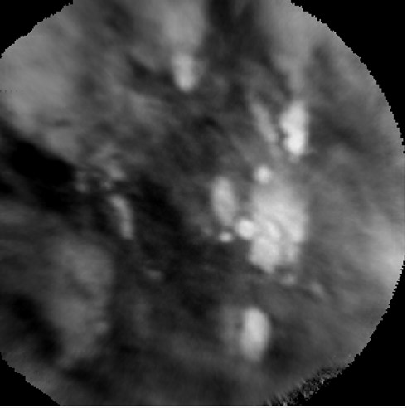
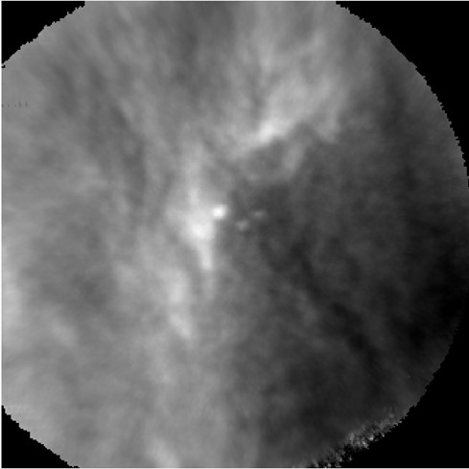
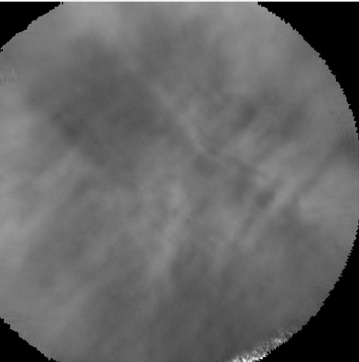
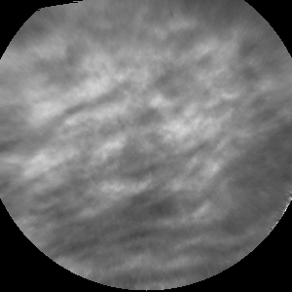
Introduction
Task:
Accurate and efficient classification of satellite infrared imagery into Cloud and Clear categories using machine learning (ML) is essential for ensuring the reliability of temperature measurements.
We use segmentation to divide each image into smaller regions to reliably identify cloud-covered areas, enhancing the correction process of AGW temperature measurements.
Examples of cloud images.
Examples of clear images.

Slide 4
Introduction
Scalability:
With millions of images captured over just a few months, manual categorization becomes nearly impossible. Our automated machine learning approach is critical for efficiently processing large datasets, ensuring rapid and accurate classification.
Novelty:
Although machine learning models exist for ground-based airglow images, there are currently no models that handle both classification and segmentation of satellite-based airglow images.

Slide 5
Machine Learning Models
To determine the most effective model for cloud detection, we compared the performance of several machine learning models:
Logistic Regression
Baseline Performance
Accuracy: 72%
Support Vector Machine (SVM)
Trying 18 different combinations of parameters
Accuracy: 77% for the best SVM model
Deep Learning
Using five different Convolutional Neuron Network (CNN) models
Accuracy: 85% for the best CNN model
Transfer Learning using ResNet-50
Adapting Pre-trained Models with ResNet-50
Accuracy: 88%

Slide 6
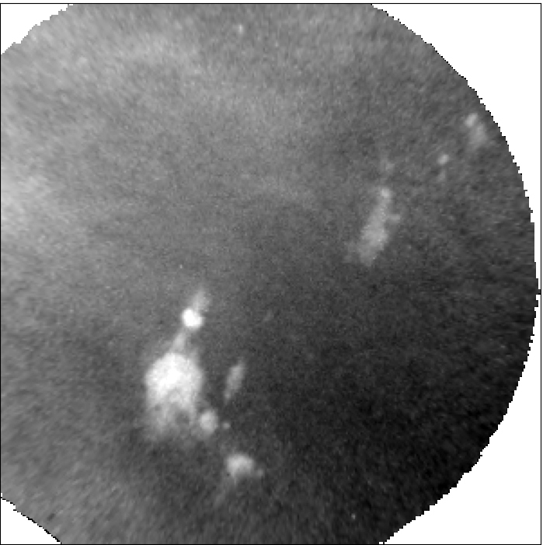
Machine Learning Models
To determine the most effective model for cloud detection, we compared the performance of several machine learning models:
Logistic Regression
Baseline Performance
Accuracy: 72%
Support Vector Machine (SVM)
Trying 18 different combinations of parameters
Accuracy: 77% for the best SVM model
Deep Learning
Using five different Convolutional Neuron Network (CNN) models
Accuracy: 85% for the best CNN model
Transfer Learning using ResNet-50
Adapting Pre-trained Models with ResNet-50
Accuracy: 88%
Transfer learning model can classify
each image correctly 88% of the time

Slide 7
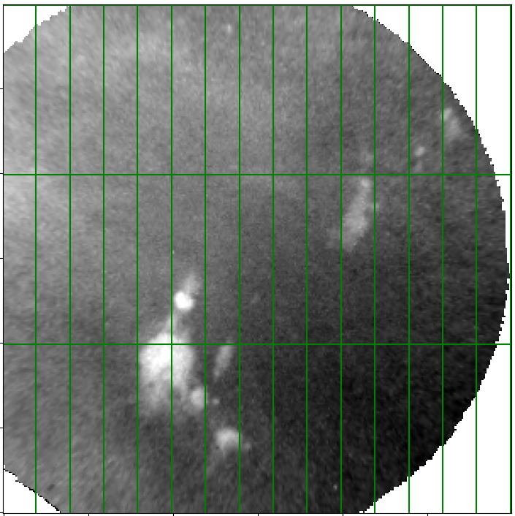
Image Segmentation
Based on the success of using transfer learning model, we advanced to image segmentation.
This involves segmenting each image into smaller rectangles and identifying cloud presence in each segment.

Slide 8
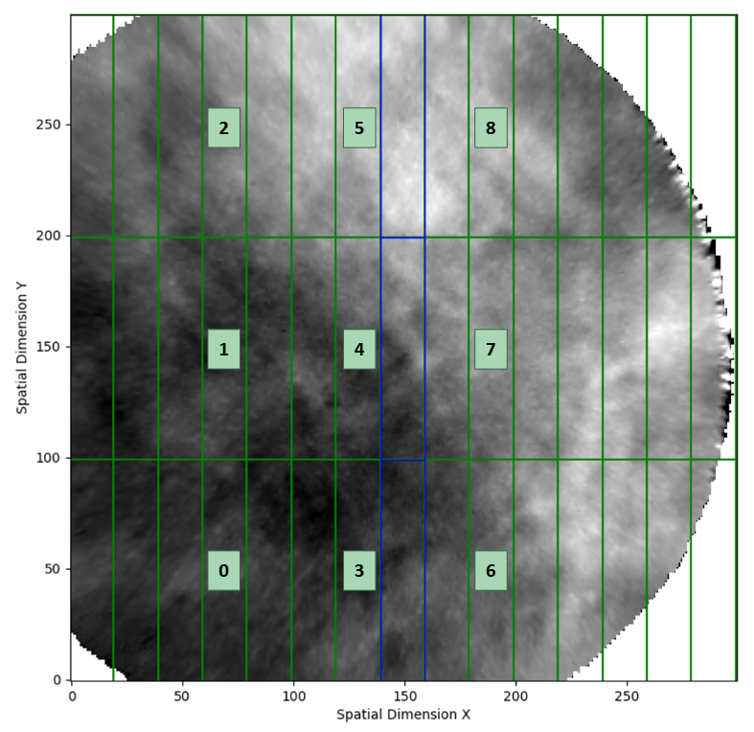
Image Segmentation
The images are segmented into 45 smaller boxes (15x3 grid). The 5 boxes on the right are excluded from the analysis due to insufficient pixel data.
The machine learning model predicts cloud presence for boxes 0 to 8. These predictions are then propagated using the expected motion of the ISS, to adjacent boxes following the arrows, effectively extending the prediction across the image.
For instance, the prediction for box 0 is extended to boxes 9, 12, 15, and 18.

Slide 9
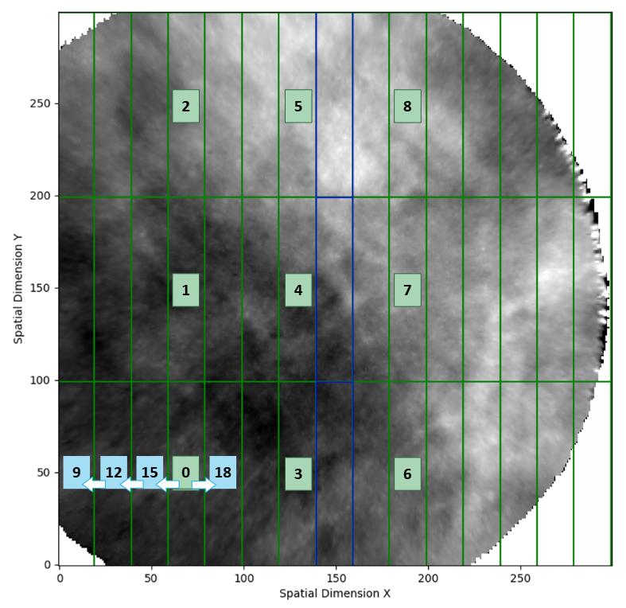
Image Segmentation
The images are segmented into 45 smaller boxes (15x3 grid). The 5 boxes on the right are excluded from the analysis due to insufficient pixel data.
The machine learning model predicts cloud presence for boxes 0 to 8. These predictions are then propagated using the expected motion of the ISS, to adjacent boxes following the arrows, effectively extending the prediction across the image.
For instance, the prediction for box 0 is extended to boxes 9, 12, 15, and 18.

Slide 10
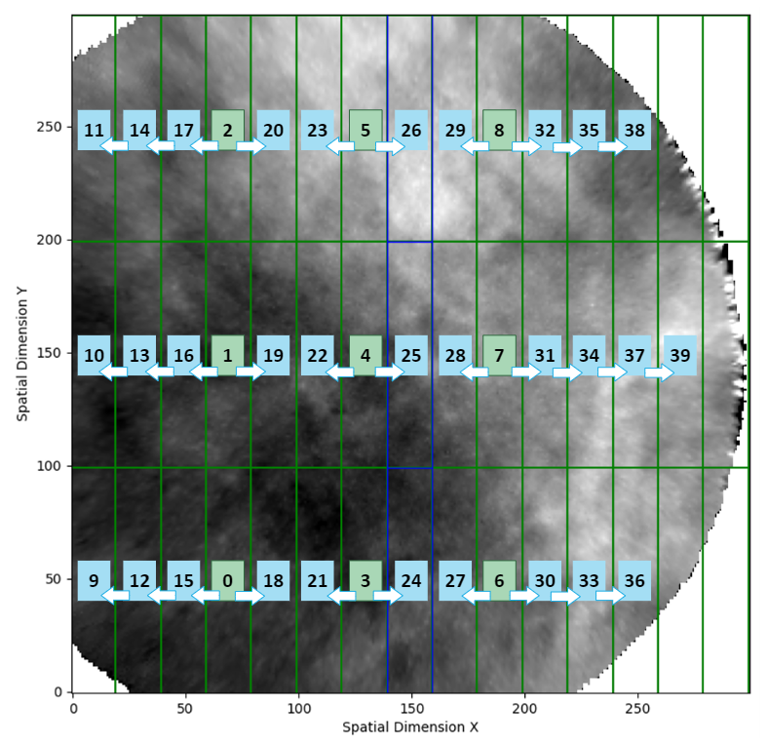
Image Segmentation
The images are segmented into 45 smaller boxes (15x3 grid). The 5 boxes on the right are excluded from the analysis due to insufficient pixel data.
The machine learning model predicts cloud presence for boxes 0 to 8. These predictions are then propagated using the expected motion of the ISS, to adjacent boxes following the arrows, effectively extending the prediction across the image.
For instance, the prediction for box 0 is extended to boxes 9, 12, 15, and 18.

Slide 11
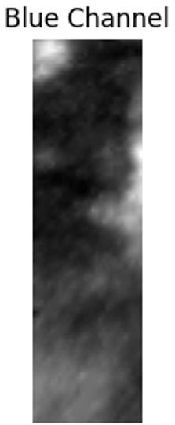
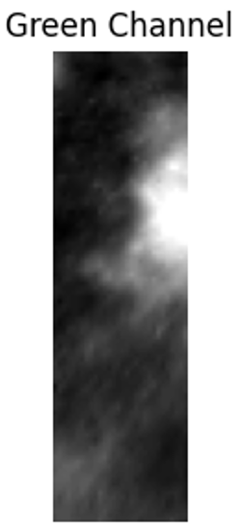
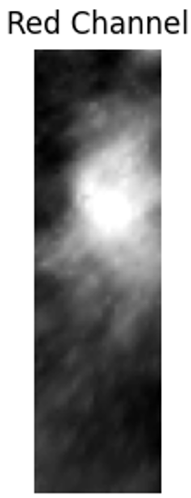
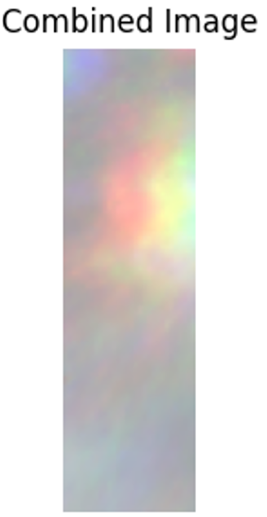
Consecutive Frames
Combine three consecutive image frames (3 frames before, current frame, and 3 frames after) into a single composite image to:
Increase pixel information.
Potentially capture apparent motion of clouds versus airglow.
3 Frames Before
Current Frame
3 Frames After

Slide 12
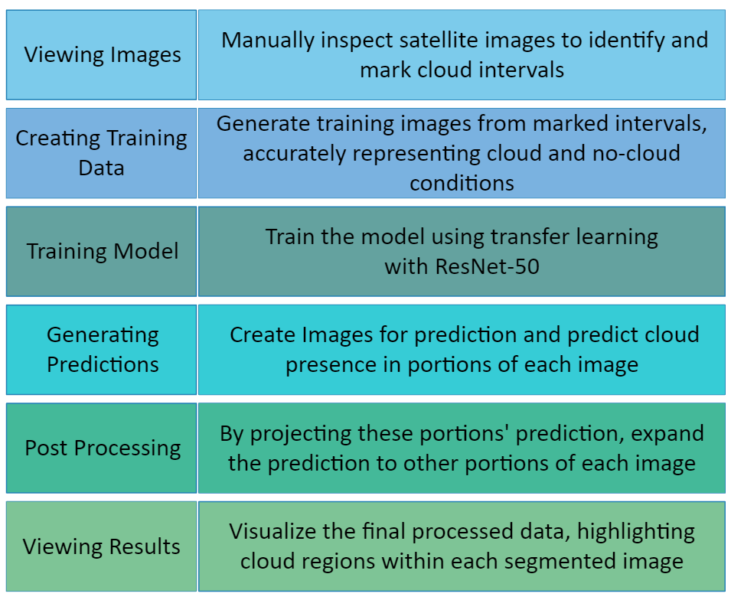
Procedure
Results:
Validation accuracy: ~80%

Slide 13
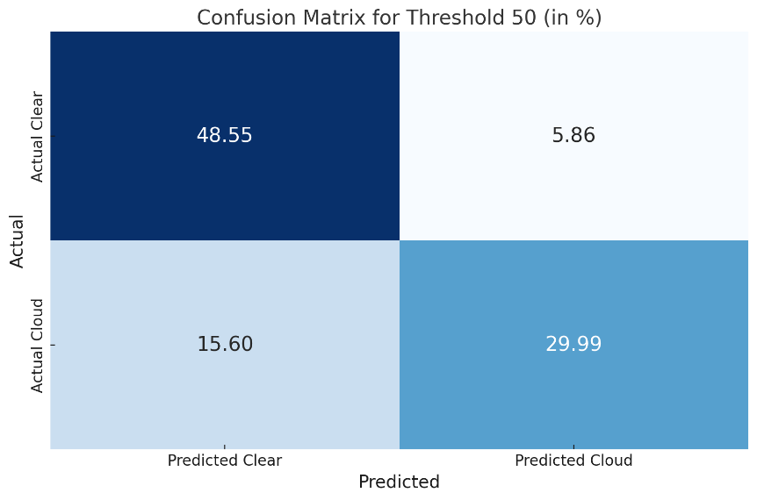
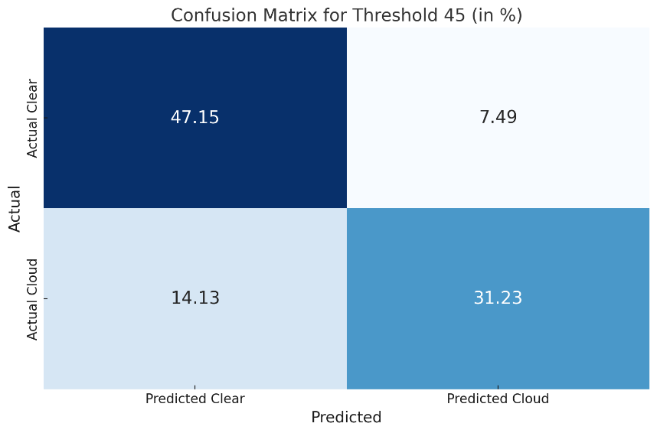
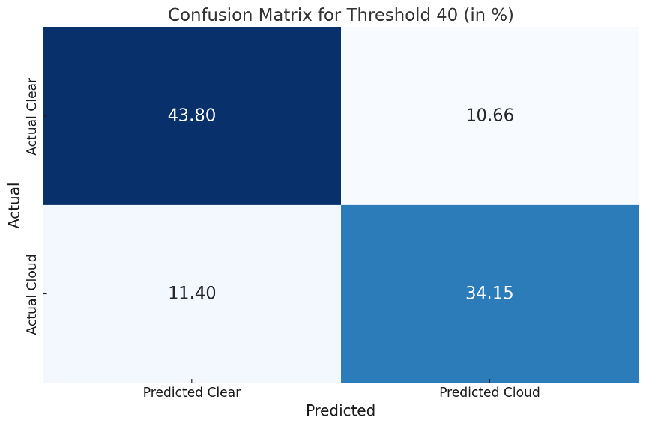
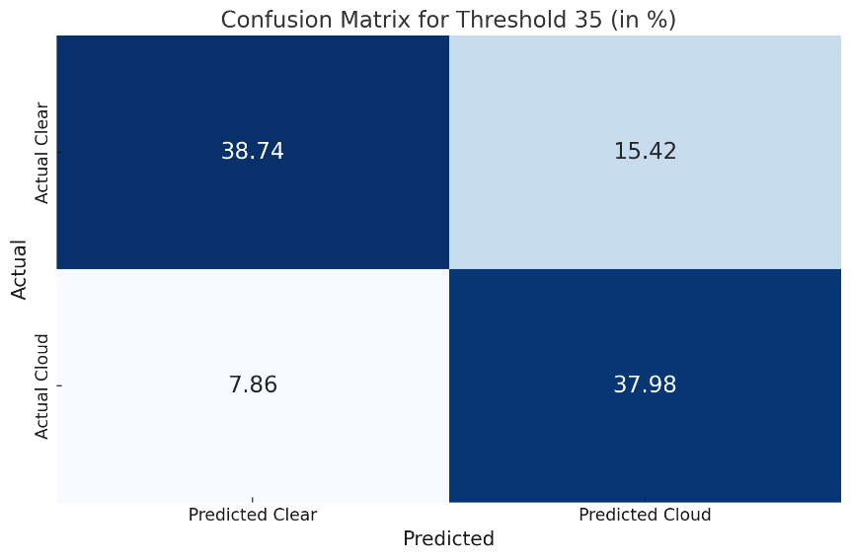
Confusion Matrix

Slide 14
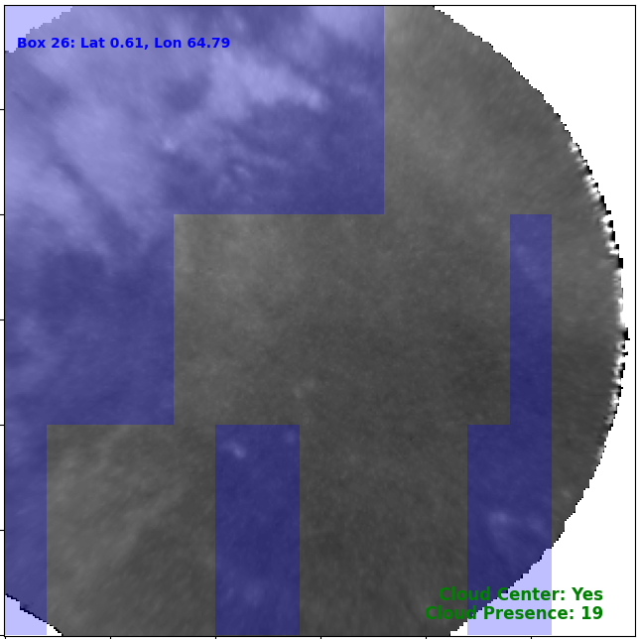
Visualization
Segmentation of a single time frame from the satellite data, visualized using the custom tool. The predicted cloud regions are highlighted in blue.
The tool also provides additional insights, including whether clouds are present in the center column of the image and the total count of cloud-affected boxes, as shown at the right lower corner of the image.

Slide 15
Conclusions
Deep learning and transfer learning models demonstrated the highest accuracy when various machine learning models were evaluated,
Advanced to image segmentation, applied to 40 smaller boxes of the original image,
Transfer learning showed promising results with 80% validation accuracy.

Slide 16
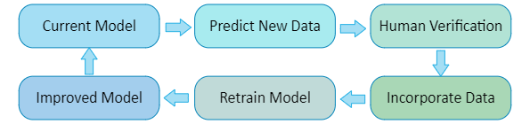
Future works
Process all data to allow users to exclude cloud-contaminated regions, enhancing the accuracy of temperature measurements. This segmentation allows for a more detailed understanding of cloud presence, leading to more accurate temperature corrections.
Develop a pipeline for future data processing and model updates.

Slide 17
Acknowledgement:
The material is based upon work supported by the National Aeronautics and Space Administration under Contract Number 80GSFC18C0007. Any opinions, findings, and conclusions or recommendations expressed in this material are those of the author(s) and do not necessarily reflect the views of NASA.

Slide 18
Thank you!

Slide 19
Additional Slides

Slide 20
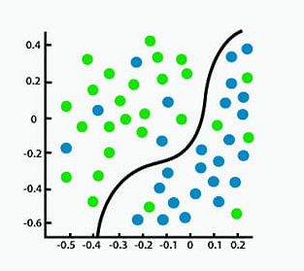
Clear
Cloud
Regression vs. Classification in Machine Learning for Beginners | Simplilearn

Slide 21
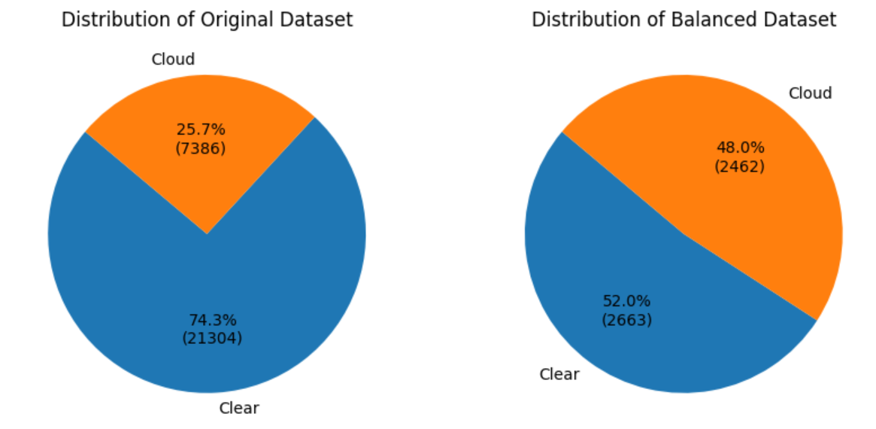
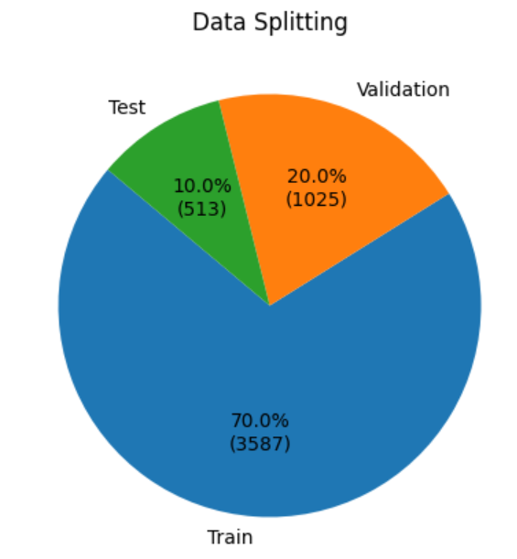
Image Classification Data
Data Overview
Data Source: Images from 15 satellite orbits on January 1st, 2024

Slide 22
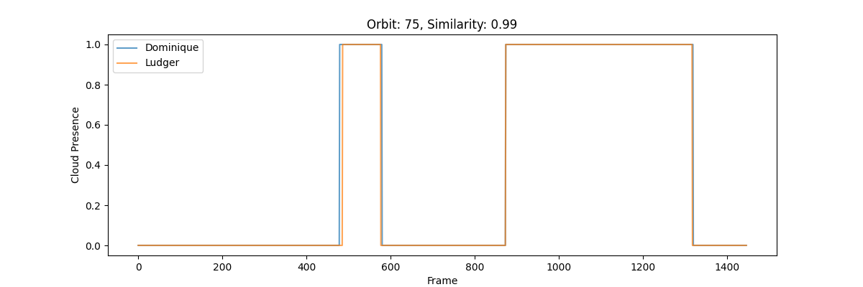
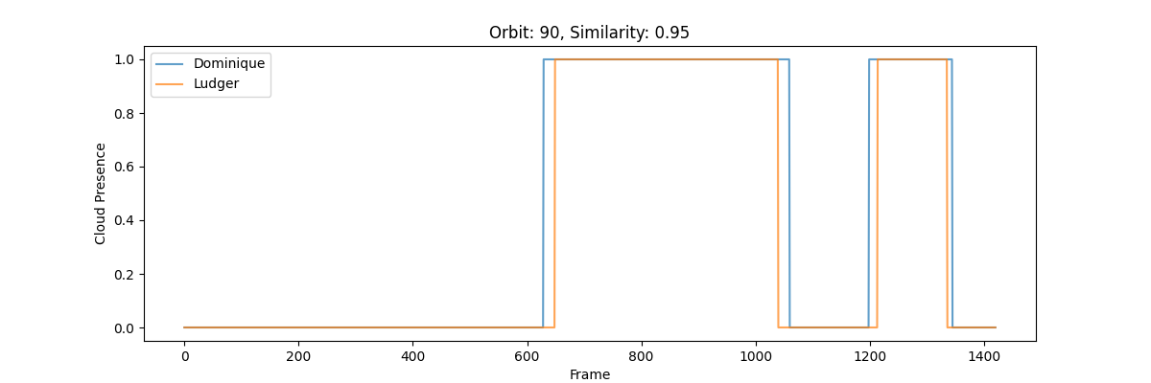
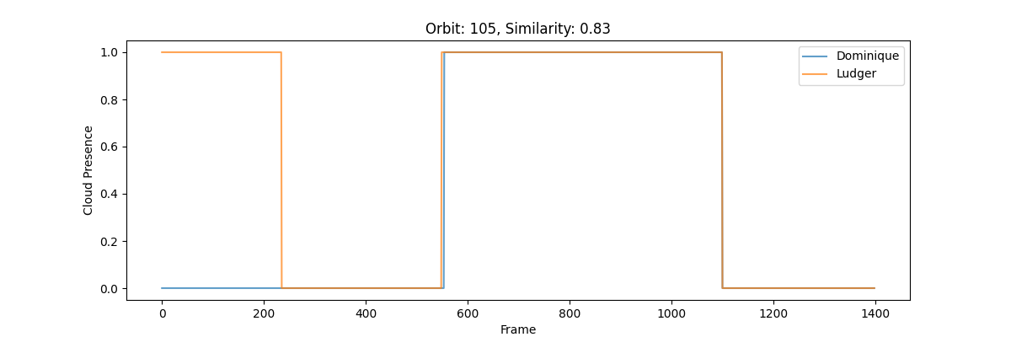
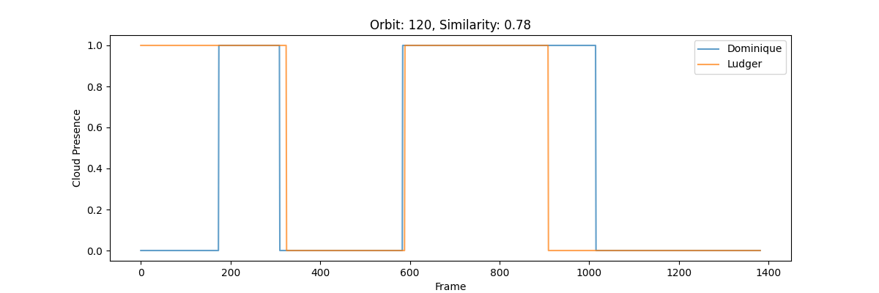
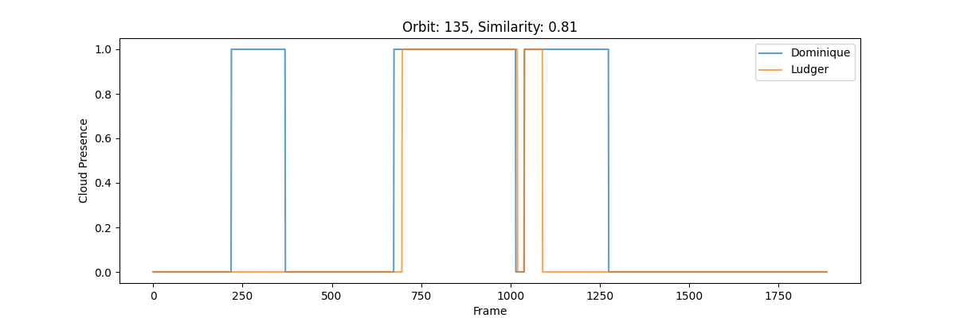

Slide 23
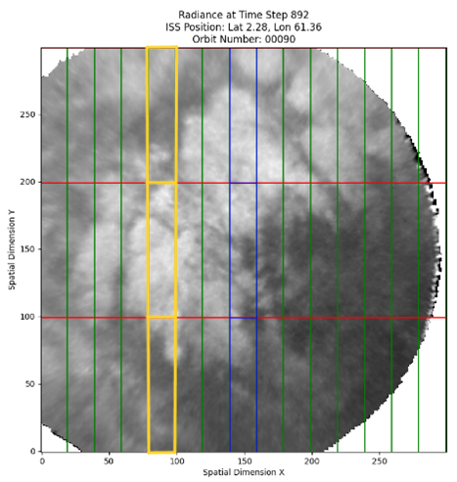
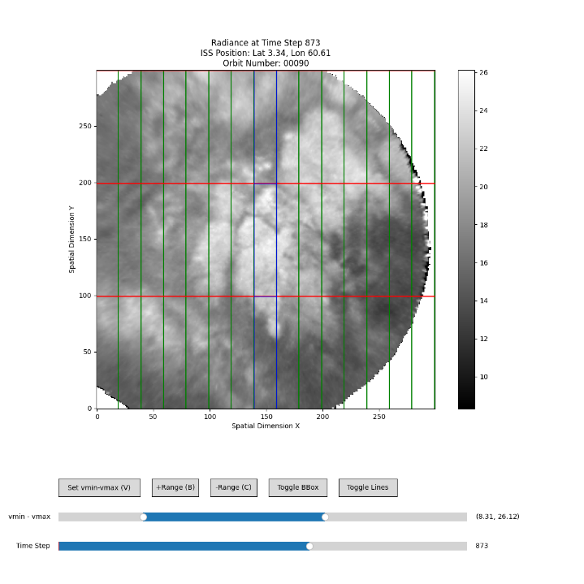
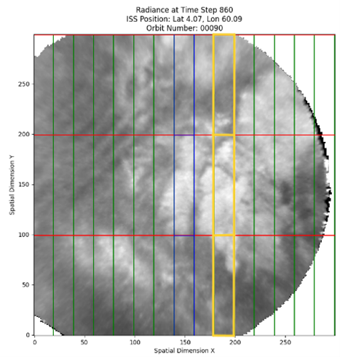
Labelling

Slide 24
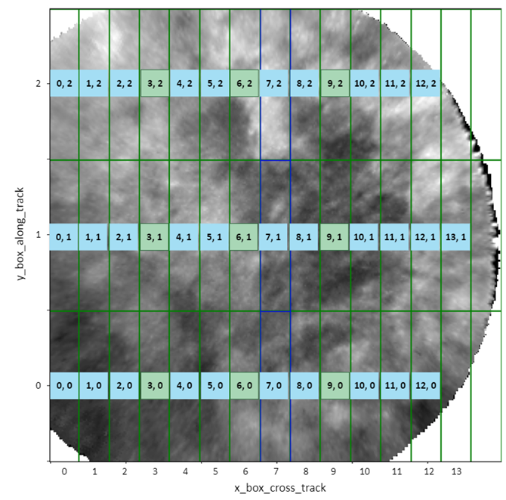

Slide 25
Confusion Matrix
Threshold | TN | FP | FN | TP | TN | FP | FN | TP | Acc
30 | 1504 | 875 | 274 | 1699 | 34.6% | 20.1% | 6.3% | 39.0% | 73.6%
31 | 1523 | 830 | 288 | 1711 | 35.0% | 19.1% | 6.6% | 39.3% | 74.3%
32 | 1571 | 787 | 293 | 1701 | 36.1% | 18.1% | 6.7% | 39.1% | 75.2%
33 | 1629 | 733 | 329 | 1661 | 37.4% | 16.8% | 7.6% | 38.2% | 75.6%
34 | 1670 | 699 | 339 | 1644 | 38.4% | 16.1% | 7.8% | 37.8% | 76.2%
35 | 1686 | 671 | 342 | 1653 | 38.7% | 15.4% | 7.9% | 38.0% | 76.7%
36 | 1747 | 629 | 385 | 1591 | 40.1% | 14.5% | 8.8% | 36.6% | 76.7%
37 | 1807 | 567 | 415 | 1563 | 41.5% | 13.0% | 9.5% | 35.9% | 77.4%
38 | 1823 | 541 | 449 | 1539 | 41.9% | 12.4% | 10.3% | 35.4% | 77.3%
39 | 1856 | 516 | 458 | 1522 | 42.6% | 11.9% | 10.5% | 35.0% | 77.6%
40 | 1906 | 464 | 496 | 1486 | 43.8% | 10.7% | 11.4% | 34.1% | 77.9%
41 | 1926 | 438 | 528 | 1460 | 44.3% | 10.1% | 12.1% | 33.5% | 77.8%
42 | 1940 | 411 | 548 | 1453 | 44.6% | 9.4% | 12.6% | 33.4% | 78.0%
43 | 1984 | 388 | 562 | 1418 | 45.6% | 8.9% | 12.9% | 32.6% | 78.2%
44 | 2013 | 349 | 573 | 1417 | 46.3% | 8.0% | 13.2% | 32.6% | 78.9%
45 | 2052 | 326 | 615 | 1359 | 47.2% | 7.5% | 14.1% | 31.2% | 78.4%
46 | 2050 | 320 | 612 | 1370 | 47.1% | 7.4% | 14.1% | 31.5% | 78.6%
47 | 2075 | 295 | 634 | 1348 | 47.7% | 6.8% | 14.6% | 31.0% | 78.7%
48 | 2082 | 279 | 649 | 1342 | 47.8% | 6.4% | 14.9% | 30.8% | 78.6%
49 | 2121 | 246 | 657 | 1328 | 48.7% | 5.7% | 15.1% | 30.5% | 79.2%
50 | 2113 | 255 | 679 | 1305 | 48.6% | 5.9% | 15.6% | 30.0% | 78.6%
51 | 2129 | 243 | 710 | 1270 | 48.9% | 5.6% | 16.3% | 29.2% | 78.1%
52 | 2127 | 229 | 718 | 1278 | 48.9% | 5.3% | 16.5% | 29.4% | 78.3%
53 | 2147 | 226 | 717 | 1262 | 49.3% | 5.2% | 16.5% | 29.0% | 78.3%
54 | 2157 | 211 | 739 | 1245 | 49.6% | 4.8% | 17.0% | 28.6% | 78.2%
55 | 2174 | 198 | 749 | 1231 | 50.0% | 4.5% | 17.2% | 28.3% | 78.3%
56 | 2173 | 186 | 762 | 1231 | 49.9% | 4.3% | 17.5% | 28.3% | 78.2%
57 | 2196 | 172 | 795 | 1189 | 50.5% | 4.0% | 18.3% | 27.3% | 77.8%
58 | 2196 | 172 | 813 | 1171 | 50.5% | 4.0% | 18.7% | 26.9% | 77.4%
59 | 2210 | 161 | 808 | 1173 | 50.8% | 3.7% | 18.6% | 27.0% | 77.8%
60 | 2215 | 153 | 843 | 1141 | 50.9% | 3.5% | 19.4% | 26.2% | 77.1%
61 | 2218 | 145 | 848 | 1141 | 51.0% | 3.3% | 19.5% | 26.2% | 77.2%
62 | 2240 | 134 | 848 | 1130 | 51.5% | 3.1% | 19.5% | 26.0% | 77.5%
63 | 2254 | 114 | 874 | 1110 | 51.8% | 2.6% | 20.1% | 25.5% | 77.3%
64 | 2251 | 116 | 880 | 1105 | 51.7% | 2.7% | 20.2% | 25.4% | 77.1%
65 | 2256 | 116 | 894 | 1086 | 51.8% | 2.7% | 20.5% | 25.0% | 76.8%
66 | 2265 | 111 | 920 | 1056 | 52.0% | 2.6% | 21.1% | 24.3% | 76.3%
67 | 2262 | 109 | 939 | 1042 | 52.0% | 2.5% | 21.6% | 23.9% | 75.9%
68 | 2268 | 108 | 946 | 1030 | 52.1% | 2.5% | 21.7% | 23.7% | 75.8%
69 | 2274 | 84 | 973 | 1021 | 52.3% | 1.9% | 22.4% | 23.5% | 75.8%
70 | 2281 | 91 | 994 | 986 | 52.4% | 2.1% | 22.8% | 22.7% | 75.1%

Slide 26
The Atmospheric Waves Experiment (AWE):
Mission Goals and Design
M. J. Taylor, L. Scherliess, P.-Dominique Pautet, Y. Zhao, B. Lamborn, H. Latvakoski, G. Cantwell, P. Sevilla, E. Syrstad, J. Forbes, S. Eckermann, D. Fritts, D. Janches, H. Liu, and J. Snively
COSPAR 45th Scientific Assembly
Busan, Korea
July 2024
The material is based upon work supported by the National Aeronautics and Space Administration under Contract Number 80GSFC18C0007. Any opinions, findings, and conclusions or recommendations expressed in this material are those of the author(s) and do not necessarily reflect the views of NASA.

Slide 27
Atmospheric Waves Experiment (AWE)
AWE is the first dedicated NASA mission to investigate global gravity wave (GW) properties in the upper atmosphere and their impacts on the ionosphere-thermosphere-mesosphere (ITM)
How does tropospheric weather influence space weather?

Slide 28
Atmospheric Waves Experiment (AWE)
AWE Science Objectives
Objective 1: Quantify the seasonal and regional variabilities and influences of GWs near the mesopause.
Objective 2: Identify the dominant dynamical processes controlling GWs.
Objective 3: Estimate the wider role of GWs in the ITM.

